Slide 1
Kubernetes Demystified
A practical guide

Slide 2
What is Kubernetes?
Official Definition: A platform for running applications in the cloud
Which means…
It’s a way to host your docker images in the cloud
It provides a way to scale up or down your web site and to load balance the traffic
It auto-magically recovers if something goes wrong
It provides security and resource management
It provides a way to monitor the health of your apps

Slide 3
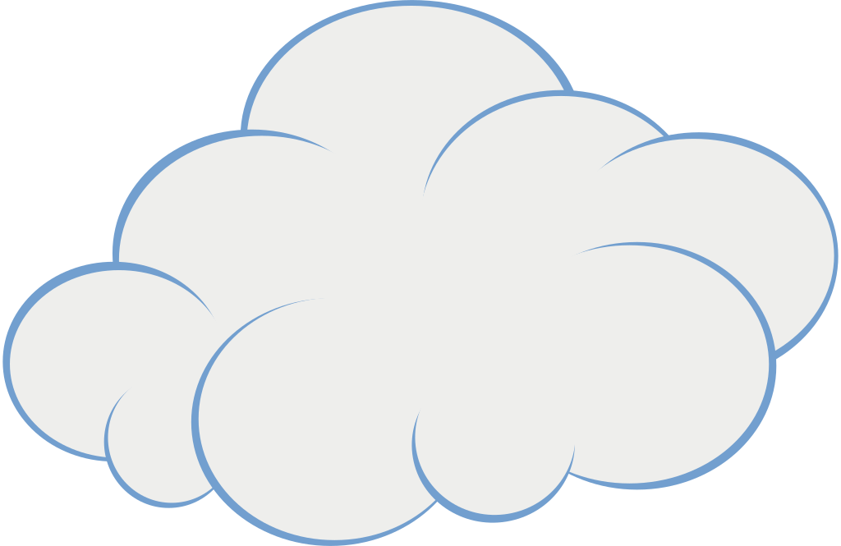
What is a cluster?
Cluster Admin
goes here
It’s defined in a cloud (any cloud will do)
Composed of a Master Node
And a few worker nodes
But this can be configured
easily
Master
Worker 2
Worker 1
Pods go here

Slide 4
What’s a pod?
It’s the most basic cluster building block
It holds containers that hold Docker Images
POD
Pod Name
Pod Labels
Metadata
Spec
Container:
Name
Image
Env var
Lifecycle
Security
Resources
Storage
…

Slide 5
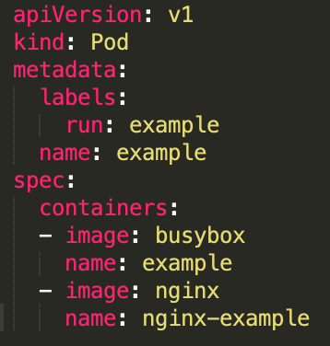
How can I define a pod? YAML is your friend
apiVersion
kind
metadata
spec
All the required elements
Note how indentation indicates parent/child relationships
The number of spaces don’t matter, just be consistent
The “-” indicates that this item is part of an array

Slide 6
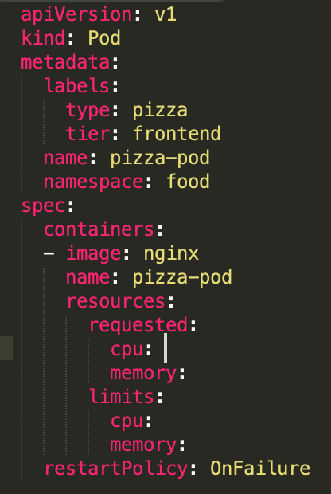
What else can be configured in a pod?
Add more properties to this file
This is where we can explain namespaces, resources, liveness probes, security, volumes

Slide 7
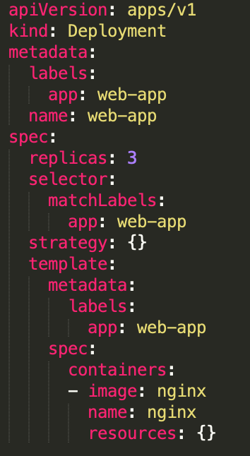
How do I create pods?
You can define an individual pod if you want to, but defining a Deployment is usually better
kind: Deployment
kind: POD
Interesting

Slide 8
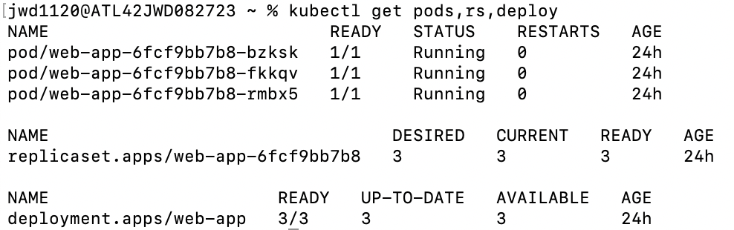
When I create a deployment, I get pods
What’s this?

Slide 9



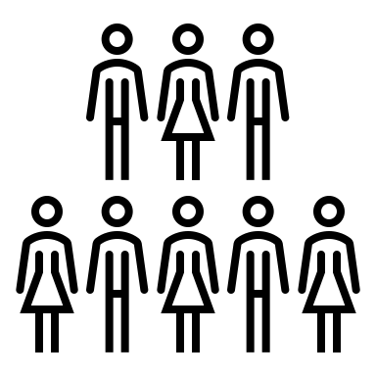

What’s a Deployment?
If a pod crashes or gets deleted, the RS will create a new pod to replace it
Deployment Factory
Replica Set
Pods controlled by the Replica Set
Pod spec is defined in the deployment yaml
The deployment factory will create a new replicaset is if the number of requested pods goes up or down
A new pod is created by the replicaset if the number requested <> number of active pods

Slide 10
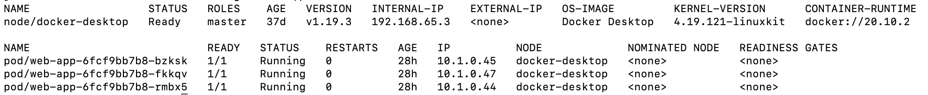

Wait a minute…
If pods are getting created and destroyed, how can we communicate with them consistently? Each pod has its own IP address…
When the RS creates a new pod, it gives it a new IP address
So how can we communicate with pods when their addresses are changing?

Slide 11

Services to the rescue!
Requests
The service keeps track
of the pod IP addresses.
New endpoints are created.
My pod makes a request to the service,
and the service forwards the request to a pod
Service IP
Addresses
don’t Change

Slide 12
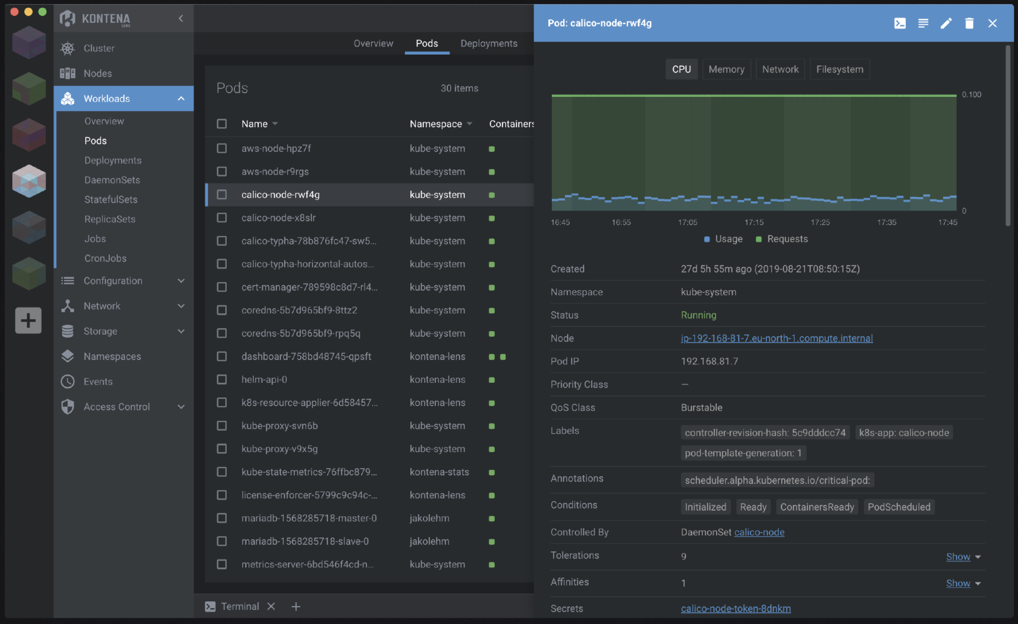
How do I get info about my cluster?
The simple answer is an app called Lens -> https://k8slens.dev/
There are
other tools too,
but I really
like this one

Slide 13
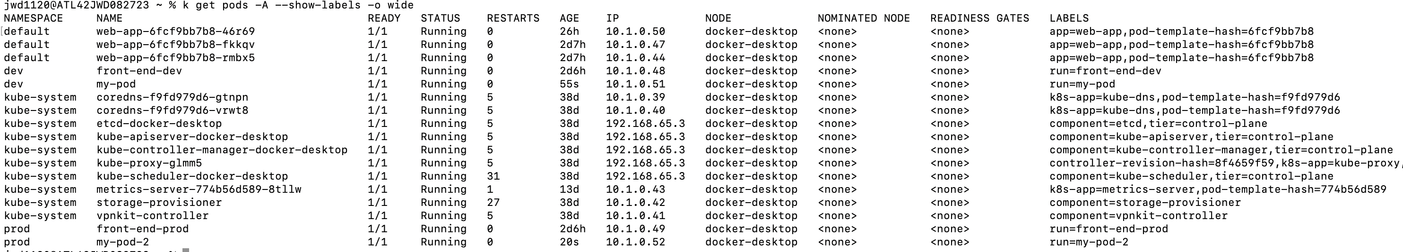
kubectl is your friend
kubectl <verb> <resource type> <resource name> <output flags>
kubectl get pods –A –show-labels –o wide
Labels
Namespaces
IP Addresses

Slide 14
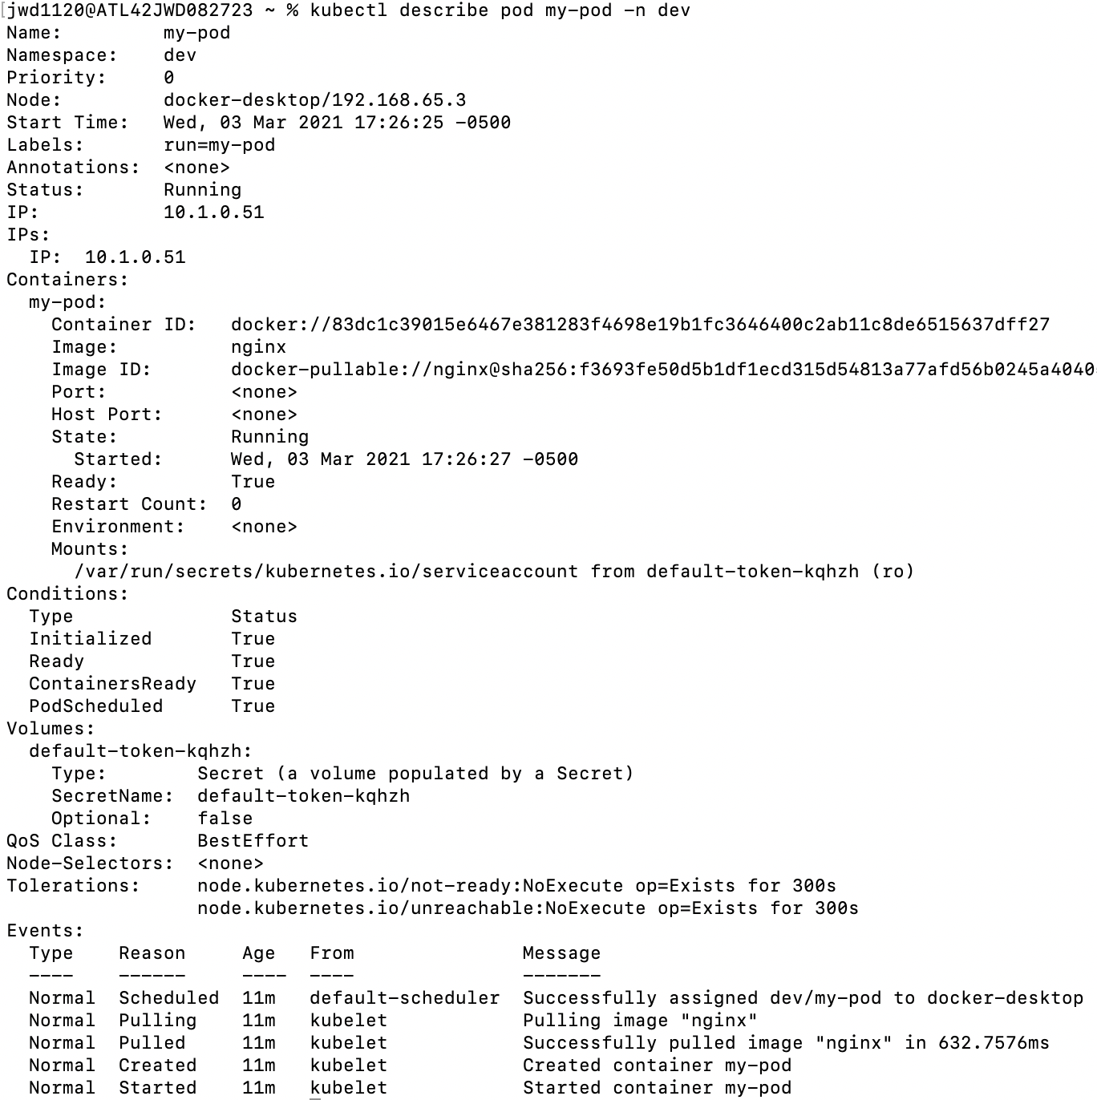
kubectl describe
Metadata
Containers
kubectl describe pod my-pod –n dev
Pod Status
Events

Slide 15
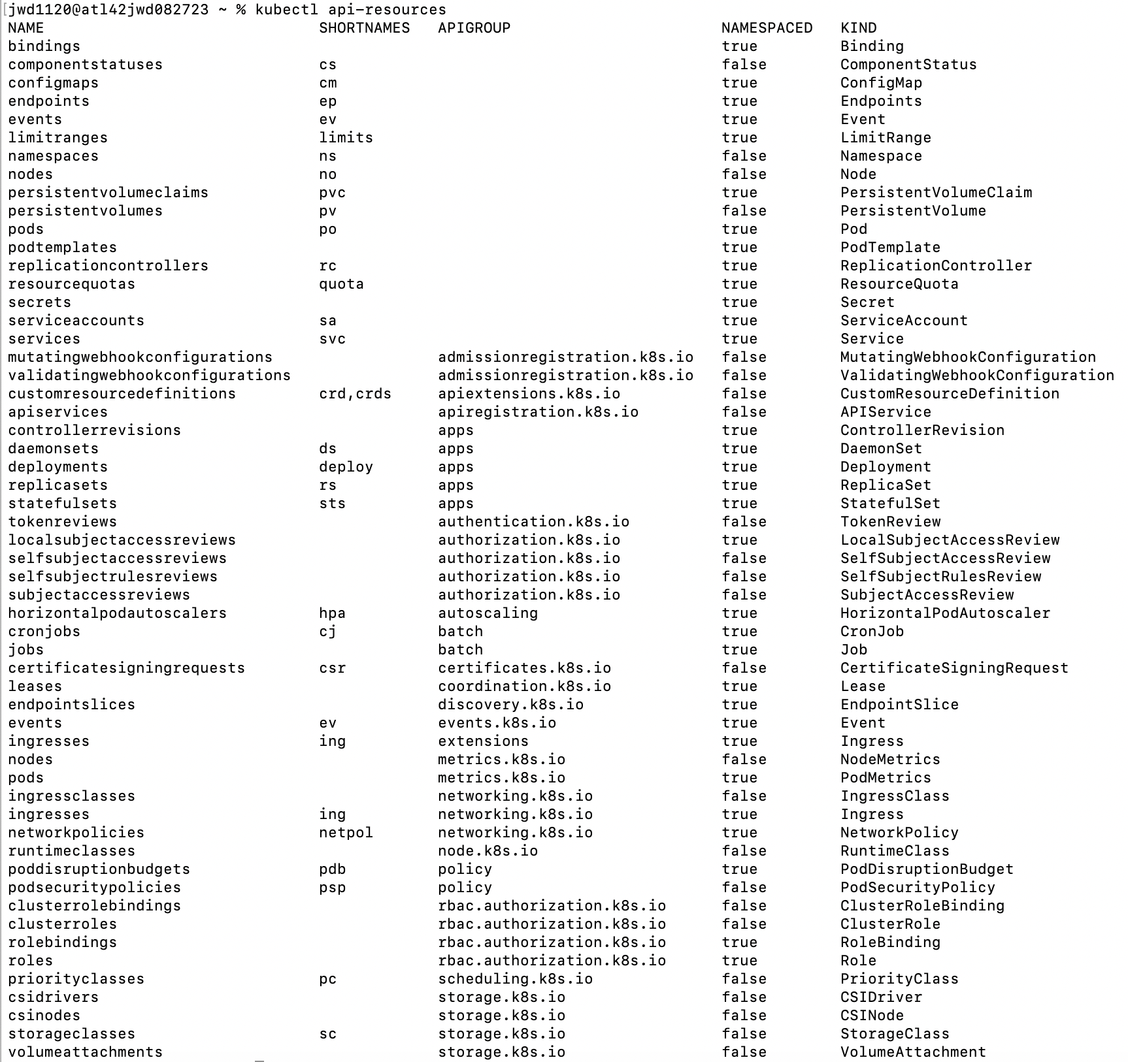
What types of resources exist?
kubectl api-resources
These shortcuts
are a real
timesaver!

Slide 16
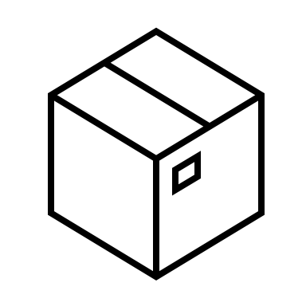
Common pod design patterns - 1
Sidecar
POD
I can be a REST endpoint for you!
Within one pod,
containers can call each other
via localhost:<port>
How can I help you?
Primary container
Sidecar (helper) container

Slide 17

Common pod design patterns - 2
Ambassador
I can connect to remote servers for you!
POD
Let me help with
outbound communication
Remote Server
Primary container
Ambassador container

Slide 18
Common pod design patterns - 3
Adapter
I can expose a port, and then forward incoming traffic to you
POD
I can forward the traffic to
a port you like better
Traffic coming in
on port 80
Primary container
Adapter container

